Slide 1


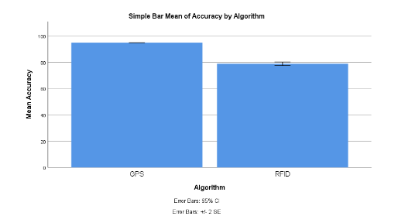

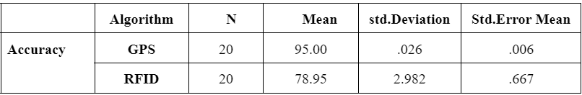
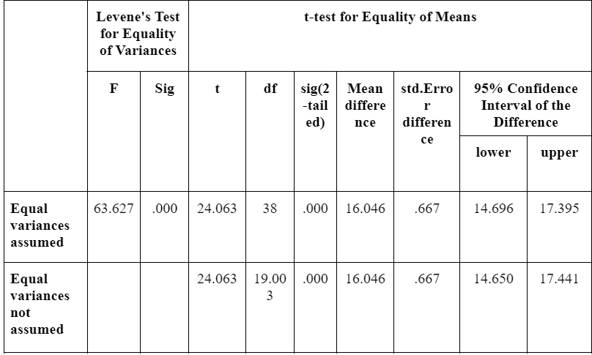
Name: Tathireddy Teja Register Number: 192110191
Guided by: Dr.D.Manikevalen
Ms. Poorani.S
Guided by Dr. Mary Valantina. G
Enhancing the shipment tracking system that utilizes mobile connectivity of Global positioning system(GPS) comparison with RFID
INTRODUCTION
The aim of the project is to Enhancing the shipment tracking system that utilizes mobile connectivity of Global positioning system(GPS) comparison with RFID.
Enable real-time monitoring of shipment locations, allowing for prompt interventions in case of delays or disruptions.
Enable better management of inventory, transportation, and distribution processes.
Utilize GPS technology to provide accurate location data for shipments in transit.
Integrate data from GPS and RFID systems to provide comprehensive tracking information, including location, timestamp, and status updates.
Records of past shipments, including origin, destination, transit times, and any incidents or delays encountered.
Shipment tracking system
MATERIALS AND METHODS
Material Selection
Software Development
Security and Compliance
Hardware Integration
Integration and Testing
Data Management and Analytics
Accuracy
95%
RESULTS
GPS and RFID
Global Positioning System (GPS) and RFID. Both algorithms were applied to 20 samples each. The mean value achieved by the Global Positioning System (GPS) was 95.00, surpassing the mean of 78.95% obtained by the RFID algorithm.
The standard deviations for the Global Positioning System (GPS) and RFID were 0.26 and 2.982 respectively. Moreover, the standard error means were 0.006 for the Global Positioning System (GPS) and 0.667 for RFID.
DISCUSSION AND CONCLUSION
The mean accuracy achieved by the GPS algorithm is significantly higher (95.47) compared to the RFID algorithm (78.95), indicating that GPS technology provides more precise location data for tracking shipments. This higher mean accuracy suggests that GPS is better suited for applications where precise location information is crucial, such as logistics and supply chain management.
Moreover, the standard deviation for the GPS algorithm (0.26) is notably lower than that of the RFID algorithm (4.356). This indicates that the GPS algorithm provides more consistent and reliable results across different samples, making it a more dependable choice for real-time tracking applications.
The statistical analysis further confirms the superiority of the GPS algorithm over RFID, with the independent sample t-test revealing a statistically significant difference between the two algorithms at a 95% confidence interval (p < 0.05).
BIBLIOGRAPHY
Singh, Ajit, and Sonal. n.d. “An Improvement over Kalman Filter for GPS Tracking.” Accessed March 7, 2024. https://ieeexplore.ieee.org/abstract/document/7724398/.
Tao, Ning. n.d. “Vehicular GPS Monitor System Based on GPRS Network.” Accessed March 7, 2024.
Wong, and Reshetnikov. n.d. “Hybrid Tracking Technology.” Accessed March 7, 2024.
Wu, Jean-Lien C., Wei-Yeh Chen, and Hung-Huan Liu. 2002. “Radio Resource Allocation in GSM/GPRS Networks.” Information Networking: Wired Communications and Management, 457–68.

